Slide 1
Exploratory Data Analysis on Film Data Using PostgreSQL
BY
ONIFADE STEPHEN MUYIWA

Slide 2
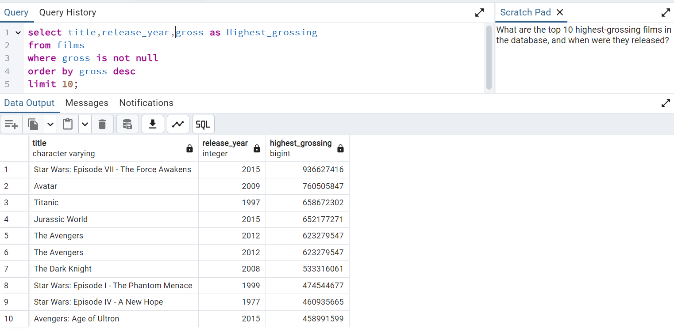
The query retrieves the top 10 highest-grossing films in the database. The results show that "Star Wars: Episode VII - The Force Awakens" (2015) tops the list with a gross of $936,627,416, followed by "Avatar" (2009) and "Titanic" (1997).

Slide 3
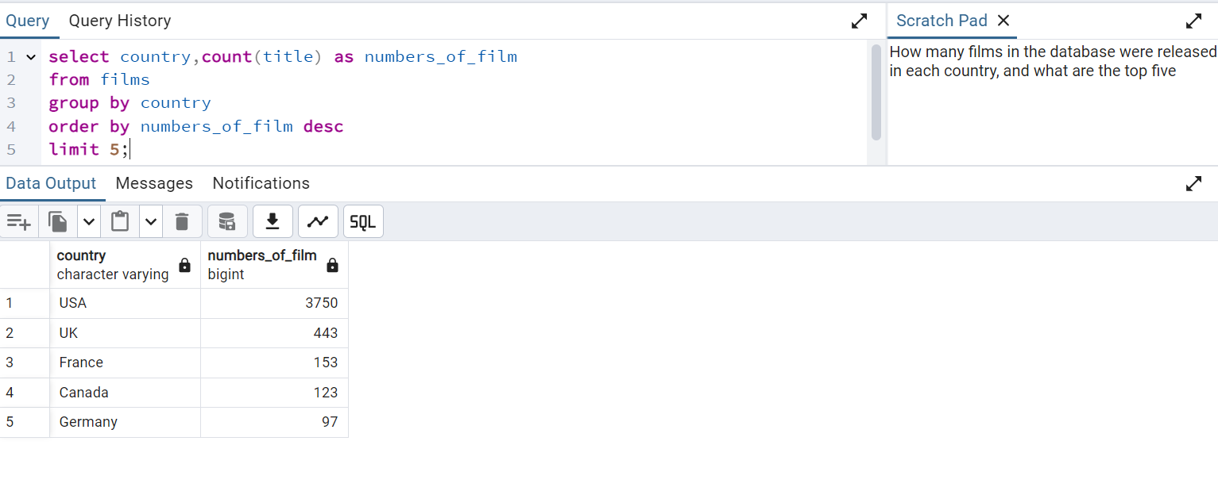
The query finds the number of films produced by each country and lists the top five. The USA leads with 3,750 films, followed by the UK with 443 films, France with 153 films, Canada with 123 films, and Germany with 97 films.

Slide 4
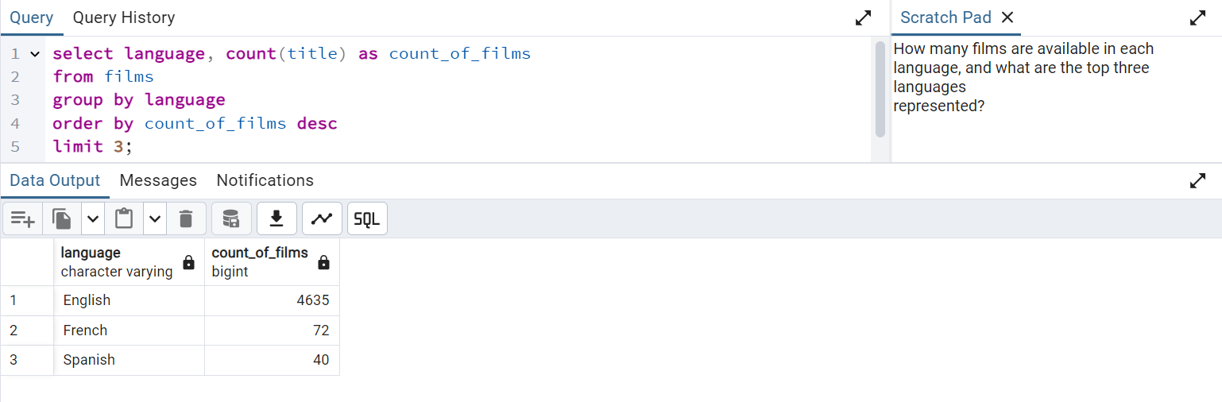
This query Return the top 3 languages with the highest number of available movies.

Slide 5
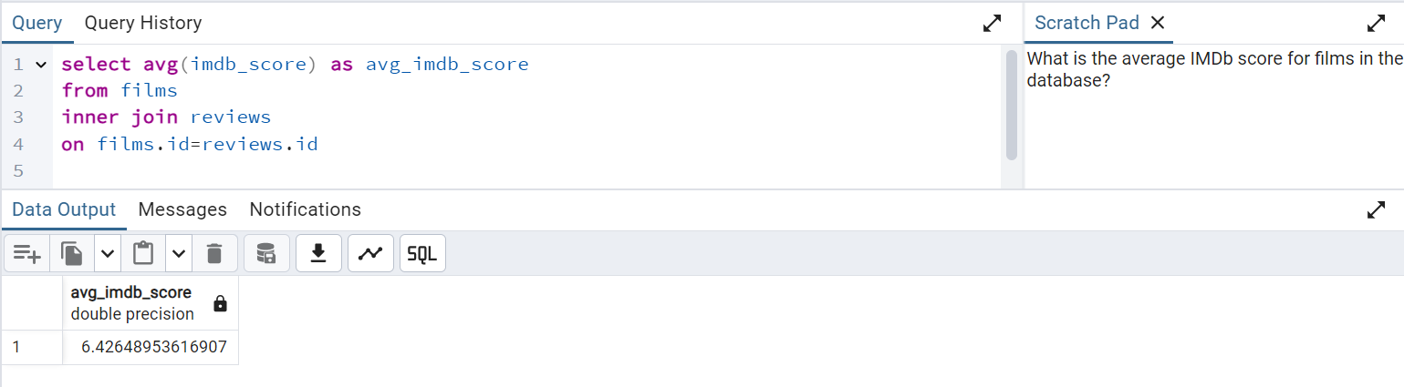
This query return the average imdb score for all the films in the database

Slide 6
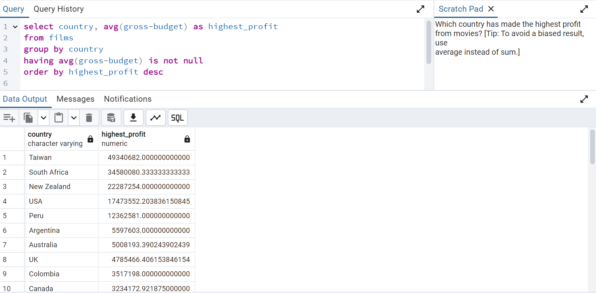
The analysis shows Taiwan leads with the highest average movie profit (~49.34M), followed by South Africa (~34.58M) and New Zealand (~22.29M). The use of averages avoids bias from outliers. These results highlight the top-performing countries in terms of movie profitability.

Slide 7
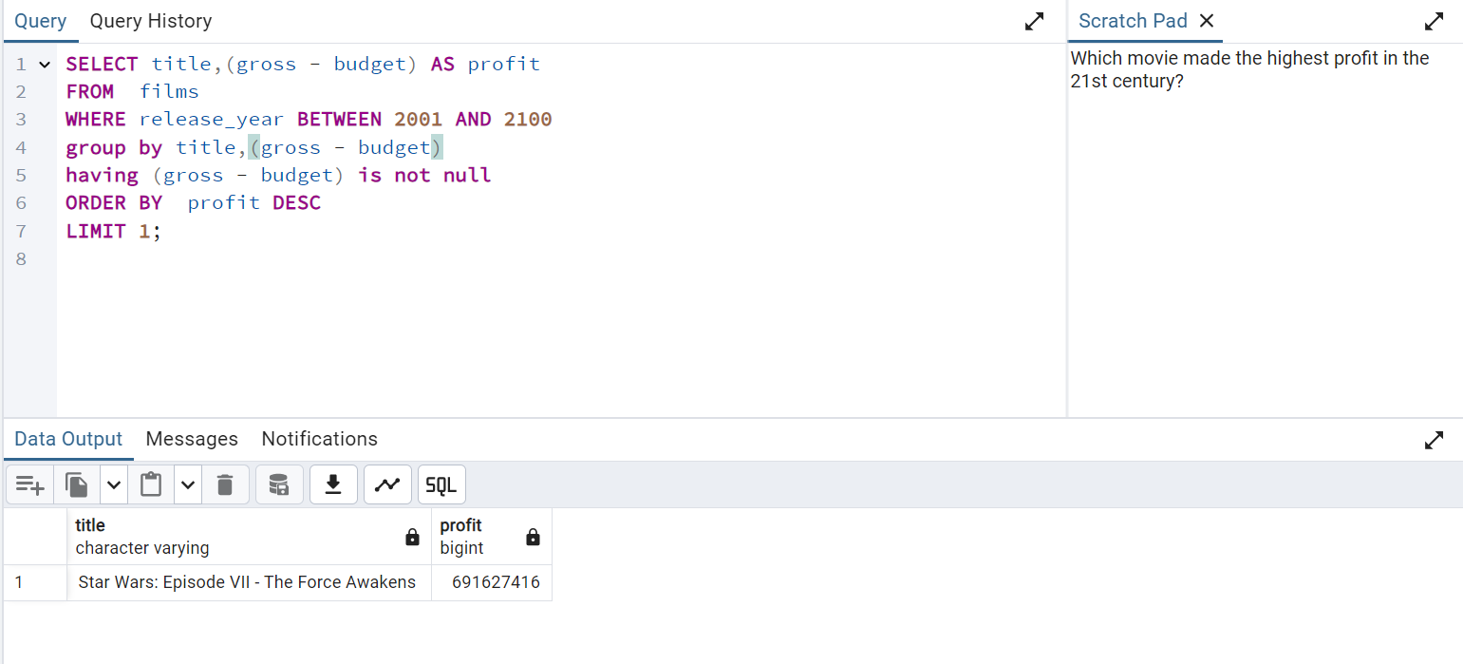
The analysis shows star wars; episode vii-the force awakens leads with the highest profit

Slide 8
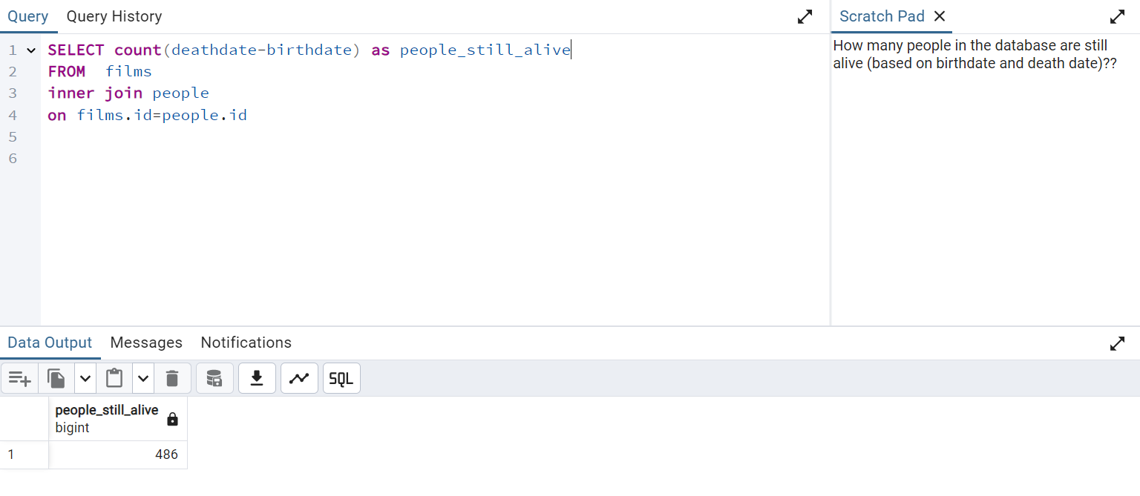
This analysis shows that 486 people are still alive

Slide 9
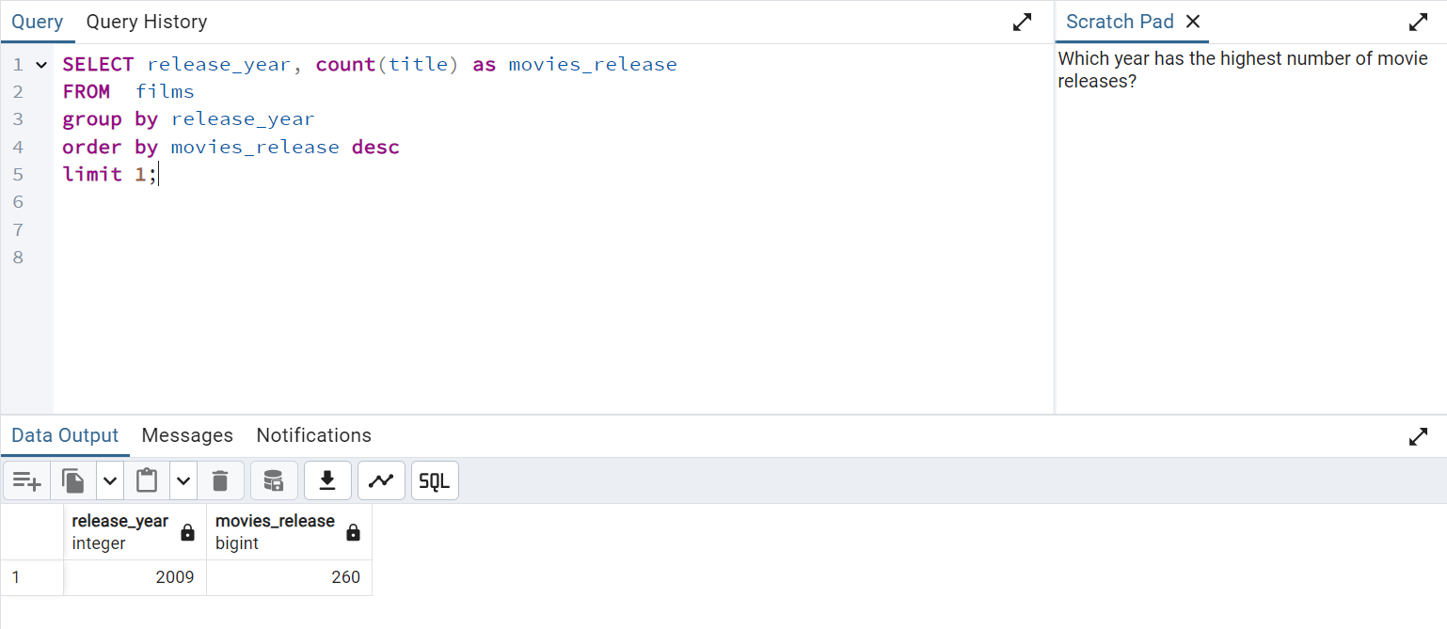
This analysis show that 2009 has the highest number of movie release in a single year.

Slide 10
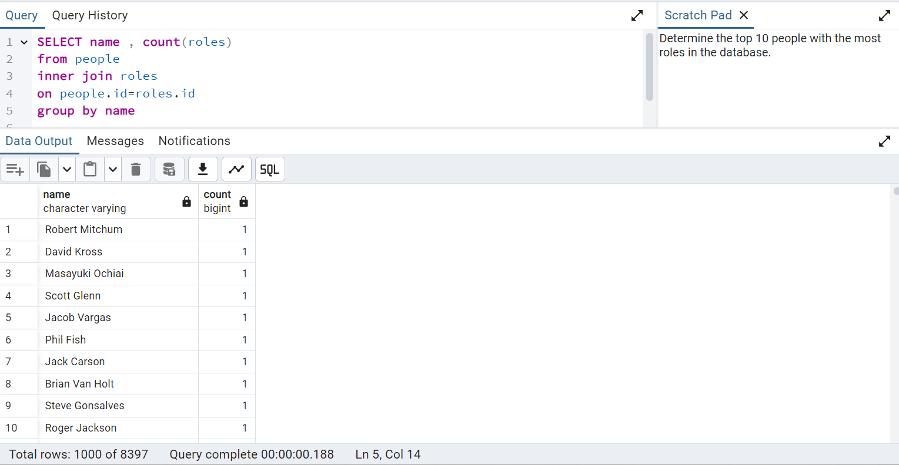
The query identifies people in the database and counts their associated roles. However, the results indicate that each person has only one role, suggesting that there are no individuals with multiple roles in the dataset.

Slide 11
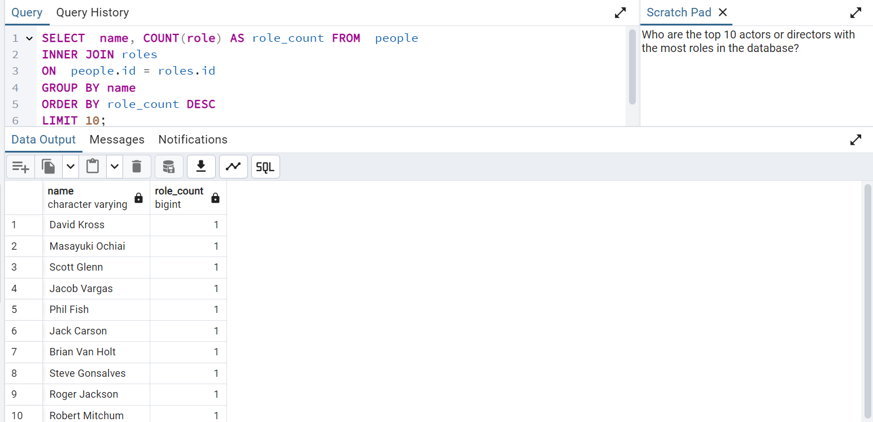
The query displays all individuals from the database along with the count of their roles, sorted by role count.

Slide 12
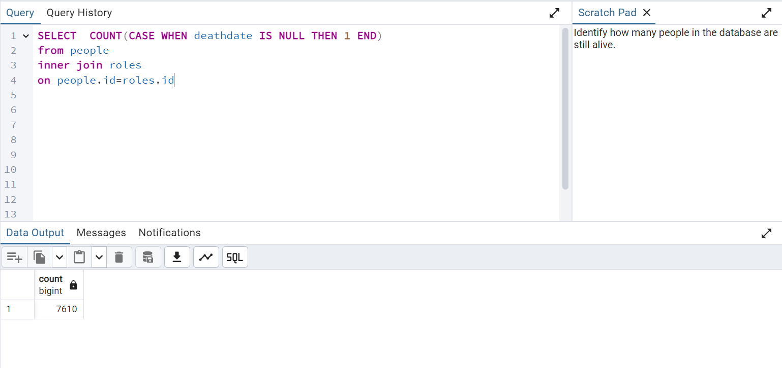
This analysis determines the number of living individuals by checking for those who do not have a death date recorded.

Slide 13
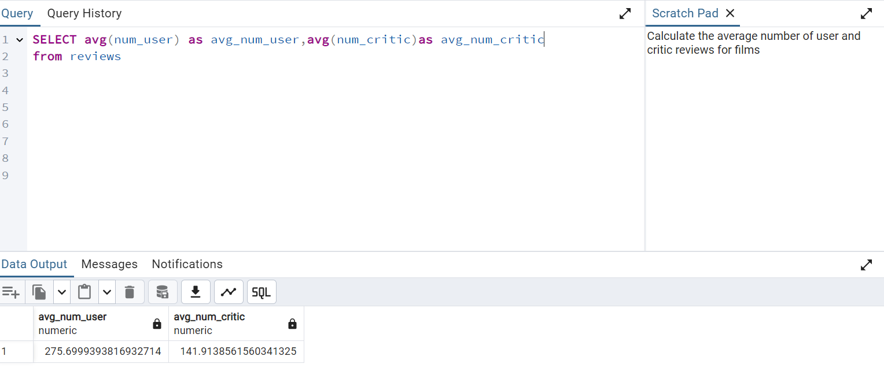
This analysis show the average number of users and critic we have in the data base

Slide 14
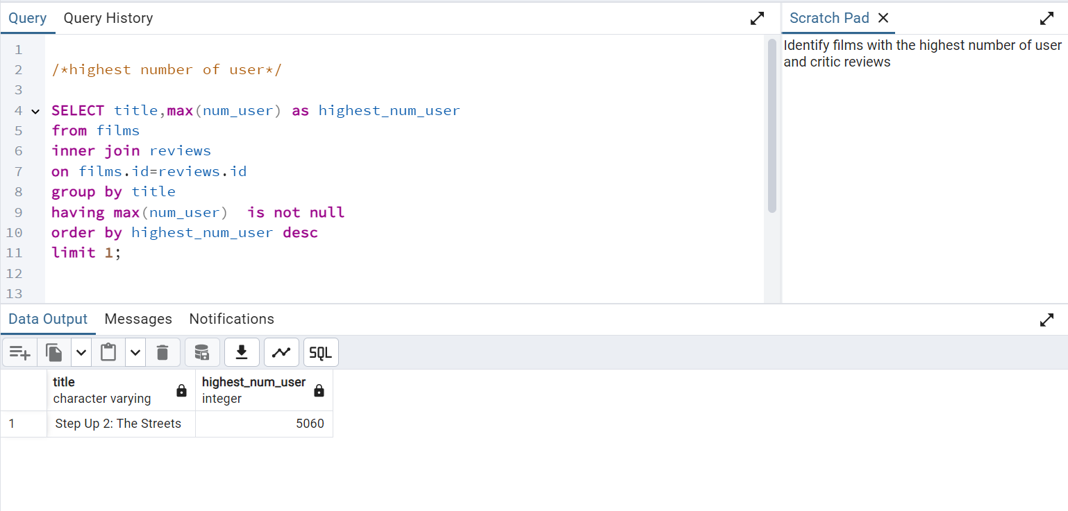
The analysis below shows the highest of users available in the database.

Slide 15
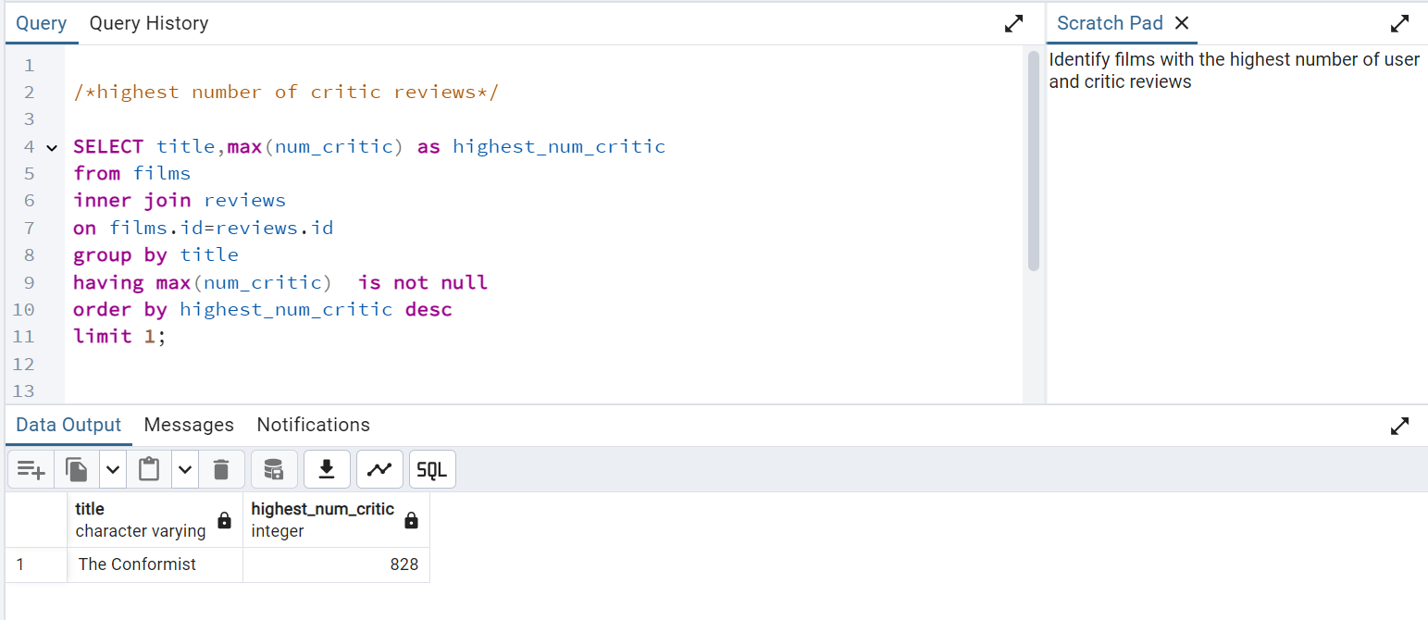
The analysis below shows the highest of critic reviews available in the database.

Slide 16
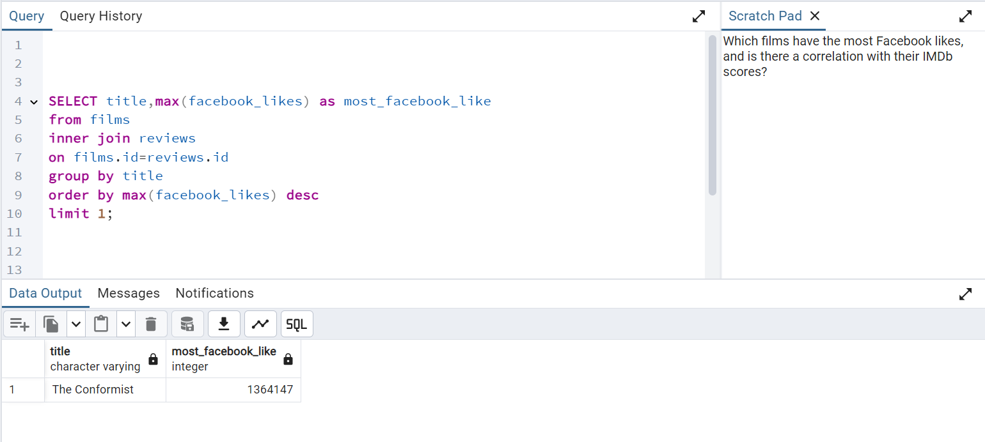
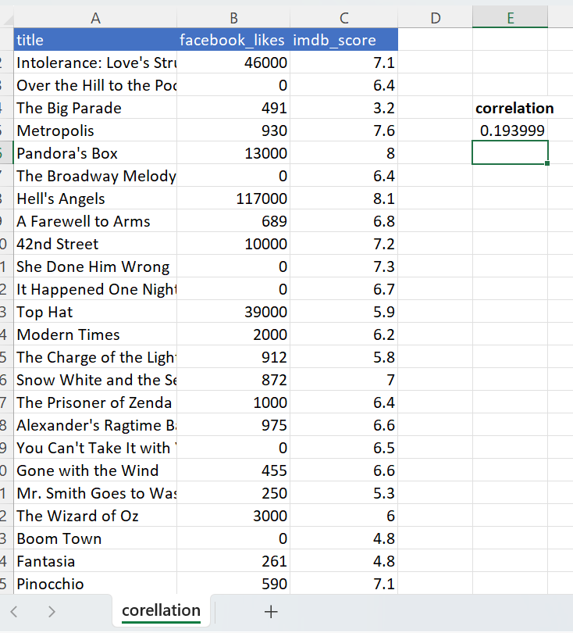
The analysis reveals that The Conformist has the highest number of Facebook likes. Additionally, an Excel correlation analysis between Facebook likes and IMDb scores indicates that there is no significant correlation between the two variables.

